Slide 1
Descriptive Statistics
Part I

Slide 2
Descriptive Statistics
In this lecture we discuss using descriptive statistics, as opposed to inferential statistics.
Here we are interested only in summarizing the data in front of us, without assuming that it represents anything more.
We will look at both numerical and categorical data.
We will look at both quantitative and graphical techniques.
The basic overall idea is to turn data into information.

Slide 3
Numerical Data – Single Variable
Numerical data may be summarized according to several characteristics. We will work with each in turn and then all of them together.
Measures of Location
Measures of central tendency: Mean; Median; Mode
Measures of noncentral tendency - Quantiles
Quartiles; Quintiles; Percentiles
Measures of Dispersion
Range
Interquartile range
Variance
Standard Deviation
Coefficient of Variation
Measures of Shape
Skewness
5-number summary; Box-and-whisker; Stem-and-leaf
Standardizing Data

Slide 4
Measures of Location
Measures of location place the data set on the scale of real numbers.
Measures of central tendency (i.e., central location) help find the approximate center of the dataset.
These include the mean, the median, and the mode.

Slide 5
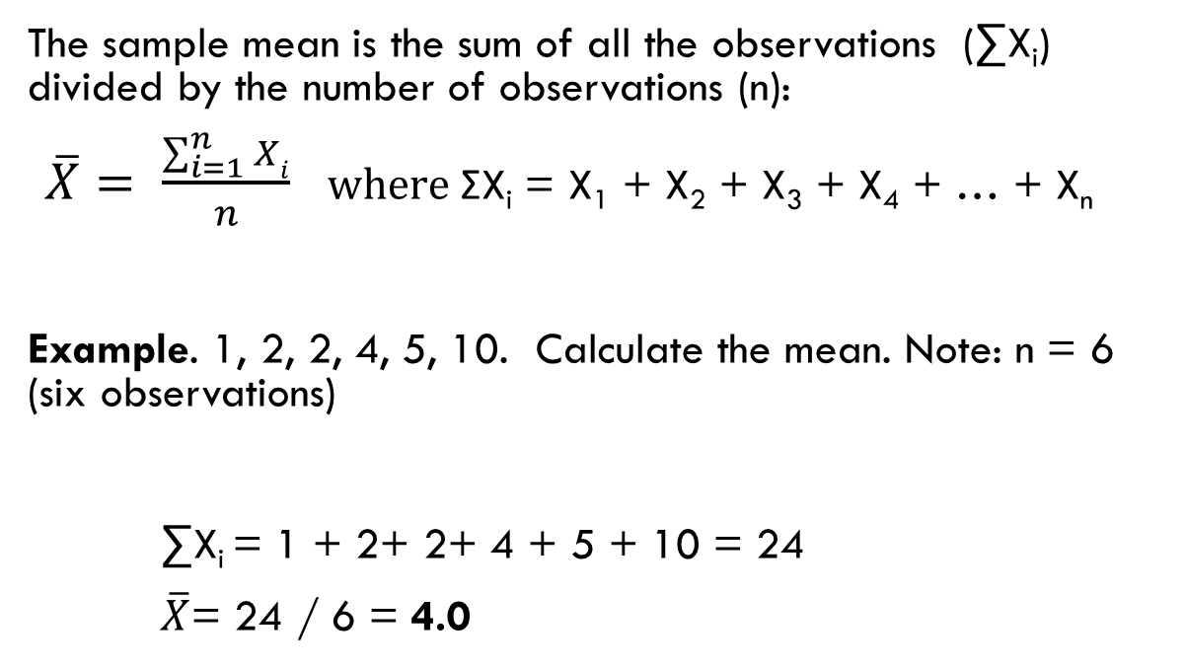
The Mean
The sample mean is the sum of all the observations (∑X_{i}) divided by the number of observations (n):
$\overline{X}= \frac{\sum_{i=1}^{n}{Xi}}{n}$ $where$ΣX_{i} = X₁ + X₂ + X₃ + X₄ + … + X_{n}
Example. 1, 2, 2, 4, 5, 10. Calculate the mean. Note: n = 6 (six observations)
∑X_{i} = 1 + 2+ 2+ 4 + 5 + 10 = 24
$\overline{X}$= 24 / 6 = 4.0

Slide 6
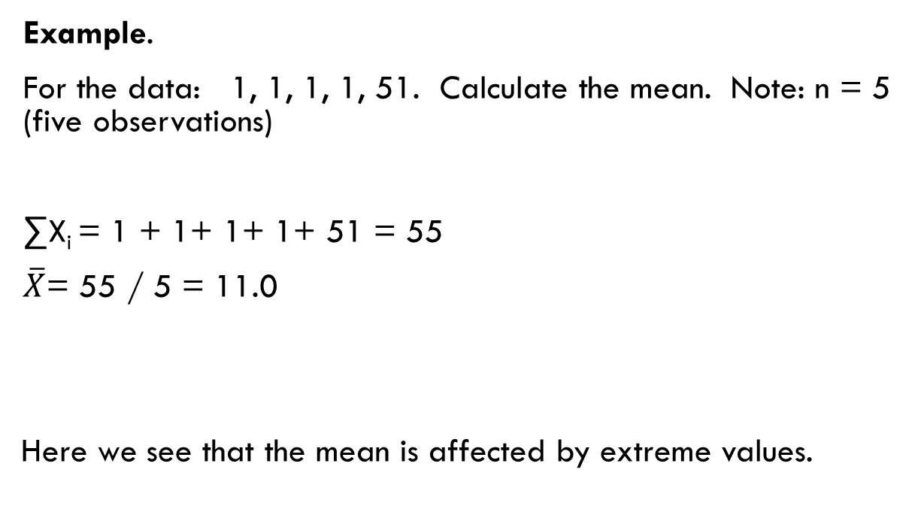
The Mean
Example.
For the data: 1, 1, 1, 1, 51. Calculate the mean. Note: n = 5 (five observations)
∑X_{i} = 1 + 1+ 1+ 1+ 51 = 55
$\overline{X}$= 55 / 5 = 11.0
Here we see that the mean is affected by extreme values.

Slide 7
The Median
The median is the middle value of the ordered data
To get the median, we must first rearrange the data into an ordered array (in ascending or descending order). Generally, we order the data from the lowest value to the highest value.
Therefore, the median is the data value such that half of the observations are larger and half are smaller. It is also the 50th percentile (we will be learning about percentiles in a bit).
If n is odd, the median is the middle observation of the ordered array. If n is even, it is midway between the two central observations.

Slide 8
The Median
0 | 2 | 3 | 5 | 20 | 99 | 100
Example:
Note: Data has been ordered from lowest to highest. Since n is odd (n=7), the median is the (n+1)/2 ordered observation, or the 4th observation.
Answer: The median is 5.
The mean and the median are unique for a given set of data. There will be exactly one mean and one median.
Unlike the mean, the median is not affected by extreme values.
Q: What happens to the median if we change the 100 to 5,000? Not a thing, the median will still be 5. Five is still the middle value of the data set.

Slide 9
The Median
10 | 20 | 30 | 40 | 50 | 60
Example:
Note: Data has been ordered from lowest to highest. Since n is even (n=6), the median is the (n+1)/2 ordered observation, or the 3.5th observation, i.e., the average of observation 3 and observation 4.
Answer: The median is 35.

Slide 10
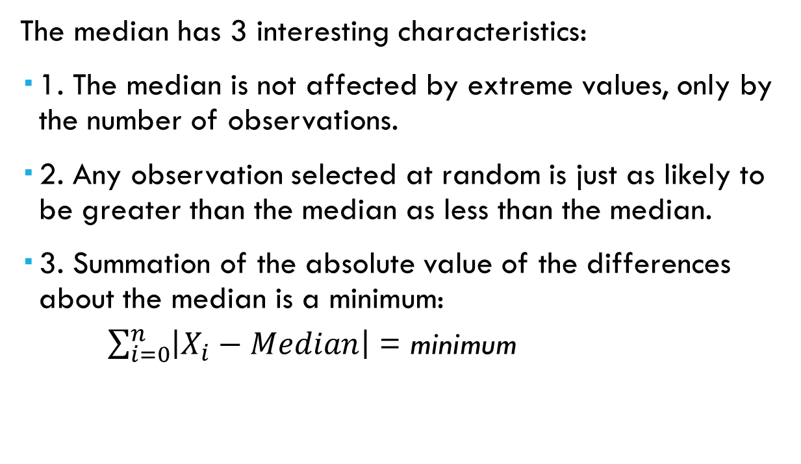
The Median
The median has 3 interesting characteristics:
1. The median is not affected by extreme values, only by the number of observations.
2. Any observation selected at random is just as likely to be greater than the median as less than the median.
3. Summation of the absolute value of the differences about the median is a minimum:
$\sum_{i=0}^{n}{\left|X_{i}−Median\right|}$ = minimum

Slide 11
The Mode
The mode is the value of the data that occurs with the greatest frequency.
Example. 1, 1, 1, 2, 3, 4, 5
Answer. The mode is 1 since it occurs three times. The other values each appear only once in the data set.
Example. 5, 5, 5, 6, 8, 10, 10, 10.
Answer. The mode is: 5, 10.
There are two modes. This is a bi-modal dataset.

Slide 12
The Mode
The mode is different from the mean and the median in that those measures always exist and are always unique. For any numeric data set there will be one mean and one median.
The mode may not exist.
Data: 1, 2, 3, 4, 5, 6, 7, 8, 9, 0
Here you have 10 observations and they are all different.
The mode may not be unique.
Data: 0, 1, 1, 2, 2, 3, 3, 4, 4, 5, 5, 6, 6, 7
Mode = 1, 2, 3, 4, 5, and 6. There are six modes.

Slide 13
Quantiles
Measures of non-central location used to summarize a set of data
Examples of commonly used quantiles:
Quartiles
Quintiles
Deciles
Percentiles

Slide 14
Quartiles
Quartiles split a set of ordered data into four parts.
Imagine cutting a chocolate bar into four equal pieces… How many cuts would you make? (yes, 3!)
Q₁ is the First Quartile
25% of the observations are smaller than Q₁ and 75% of the observations are larger
Q₂ is the Second Quartile
50% of the observations are smaller than Q₂ and 50% of the observations are larger. Same as the Median. It is also the 50th percentile.
Q₃ is the Third Quartile
75% of the observations are smaller than Q₃and 25% of the observations are larger
Some books use a formula to determine the quartiles. We prefer a quick-and-dirty approximation method outlined in the next slide.

Slide 15
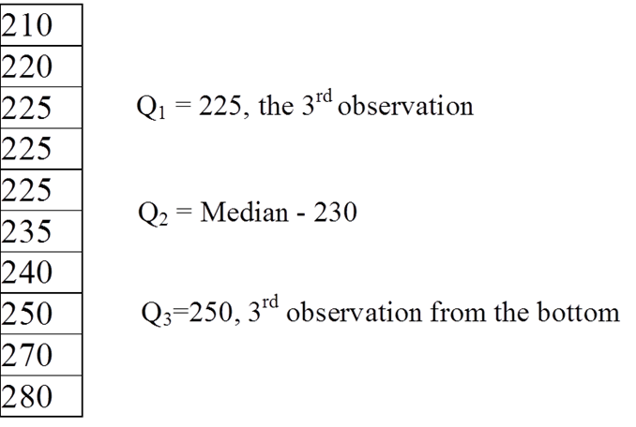
Quartiles
A quartile, like the median, either takes the value of one of the observations, or the value halfway between two observations.
The simple method we like to use is just to first split the data set into two equal parts to get the median (Q2) and then get the median of each resulting subset.
The method we are using is an approximation. If you solve this in MS Excel, which relies on a formula, you may get an answer that is slightly different.

Slide 16
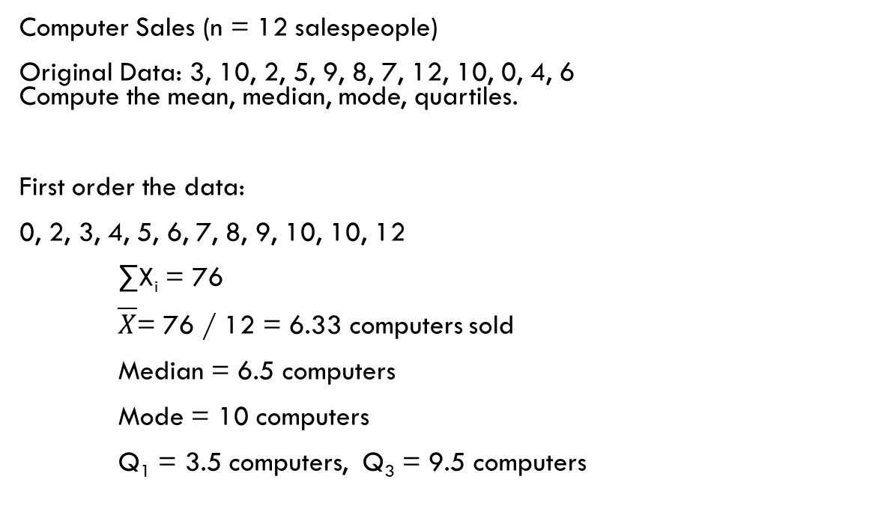
Exercise
Computer Sales (n = 12 salespeople)
Original Data: 3, 10, 2, 5, 9, 8, 7, 12, 10, 0, 4, 6 Compute the mean, median, mode, quartiles.
First order the data:
0, 2, 3, 4, 5, 6, 7, 8, 9, 10, 10, 12
∑X_{i} = 76
$\overline{X}$= 76 / 12 = 6.33 computers sold
Median = 6.5 computers
Mode = 10 computers
Q₁ = 3.5 computers, Q₃ = 9.5 computers

Slide 17
Other Quantiles
Similar to what we just learned about quartiles, where 3 quartiles split the data into 4 equal parts,
There are 9 deciles dividing the distribution into 10 equal portions (tenths).
There are four quintiles dividing the population into 5 equal portions.
… and 99 percentiles (next slide)
In all these cases, the convention is the same. The point, be it a quartile, decile, or percentile, takes the value of one of the observations or it has a value halfway between two adjacent observations. It is never necessary to split the difference between two observations more finely.

Slide 18
Percentiles
We use 99 percentiles to divide a data set into 100 equal portions.
Percentiles are used in analyzing the results of standardized exams. For instance, a score of 40 on a standardized test might seem like a terrible grade, but if it is the 99th percentile, don’t worry about telling your parents. ☺
Which percentile is Q1? Q2 (the median)? Q3?
We will always use computer software to obtain the percentiles.

Slide 19
Measures of Dispersion
Dispersion is the amount of spread, or variability, in a set of data.
Why do we need to look at measures of dispersion?
Consider this example:
A company is about to buy computer chips that must have an average life of 10 years. The company has a choice of two suppliers. Whose chips should they buy? They take a sample of 10 chips from each of the suppliers and test them. See the data on the next slide.

Slide 20
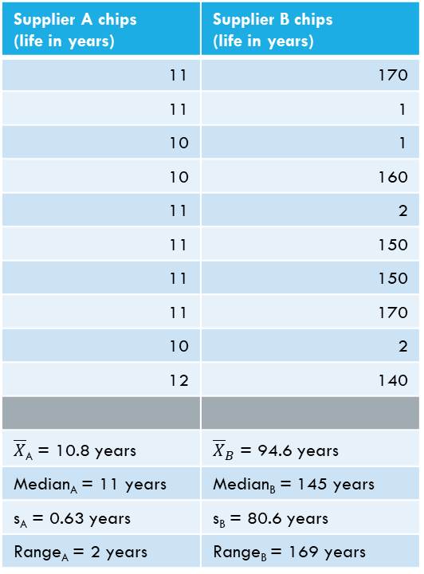
Measures of Dispersion
Supplier A chips (life in years) | Supplier B chips (life in years)
11 | 170
11 | 1
10 | 1
10 | 160
11 | 2
11 | 150
11 | 150
11 | 170
10 | 2
12 | 140
$\overline{X}$_{A} = 10.8 years | ${\overline{X}}_{B}$ = 94.6 years
Median_{A} = 11 years | Median_{B} = 145 years
s_{A} = 0.63 years | s_{B} = 80.6 years
Range_{A} = 2 years | Range_{B} = 169 years
We see that supplier B’s chips have a longer average life.
However, what if the company offers
a 3-year warranty?
Then, computers manufactured
using the chips from supplier A
will have no returns
while using supplier B will result in
4/10 or 40% returns.

Slide 21
Measures of Dispersion
We will study these five measures of dispersion
Range
Interquartile Range
Standard Deviation
Variance
Coefficient of Variation

Slide 22
The Range
Range = Largest Value – Smallest Value
Example: 1, 2, 3, 4, 5, 8, 9, 21, 25, 30
Answer: Range = 30 – 1 = 29.
The range is simple to use and to explain to others.
One problem with the range is that it is influenced by extreme values at either end.

Slide 23
Inter-Quartile Range (IQR)
IQR = Q₃ – Q₁
Example (n = 15): 0, 0, 2, 3, 4, 7, 9, 12, 17, 18, 20, 22, 45, 56, 98 Q₁ = 3, Q₃ = 22
IQR = 22 – 3 = 19 (Range = 98)
This is basically the range of the central 50% of the observations in the distribution.
Problem: The interquartile range does not take into account the variability of the total data (only the central 50%). We are “throwing out” half of the data.

Slide 24
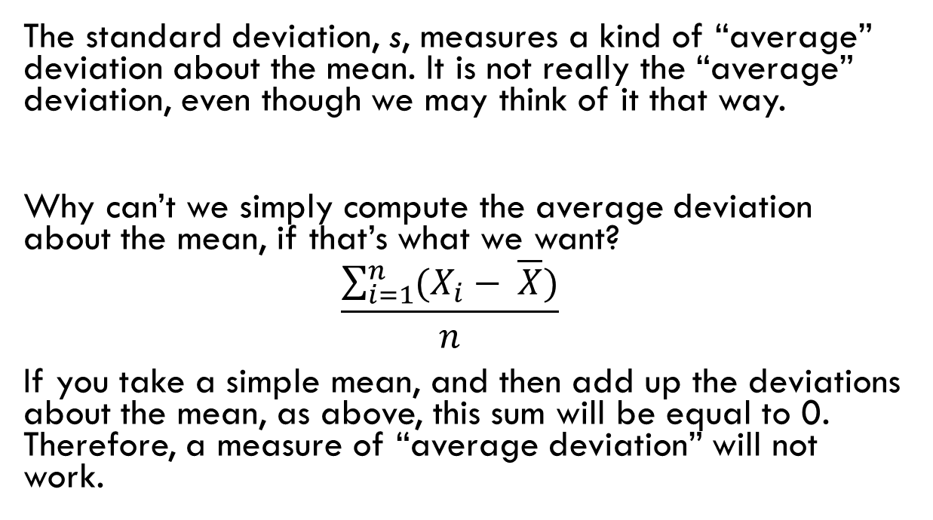
Standard Deviation
The standard deviation, s, measures a kind of “average” deviation about the mean. It is not really the “average” deviation, even though we may think of it that way.
Why can’t we simply compute the average deviation about the mean, if that’s what we want?
$$\frac{\sum_{i=1}^{n}{(X_{i}− \overline{X})}}{n}$$
If you take a simple mean, and then add up the deviations about the mean, as above, this sum will be equal to 0. Therefore, a measure of “average deviation” will not work.

Slide 25
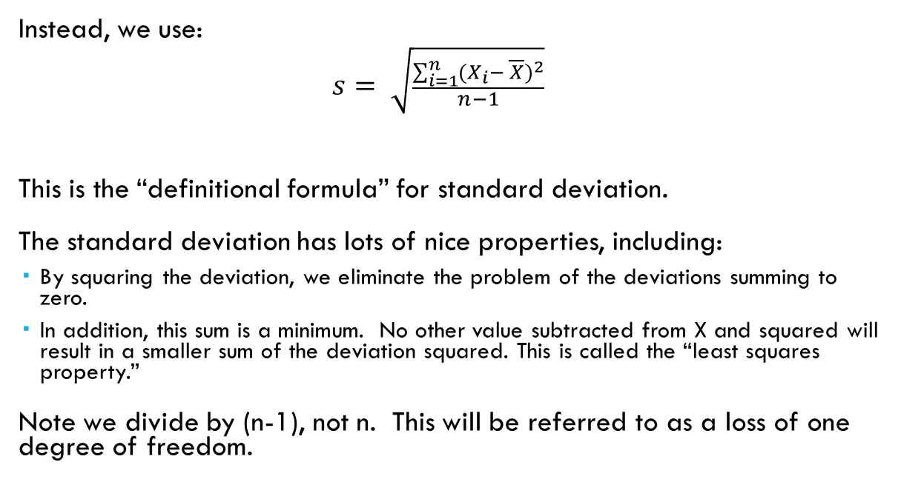
Standard Deviation
Instead, we use:
$$s= \sqrt{\frac{\sum_{i=1}^{n}{{(X_{i}− \overline{X})}^{2}}}{n−1}}$$
This is the “definitional formula” for standard deviation.
The standard deviation has lots of nice properties, including:
By squaring the deviation, we eliminate the problem of the deviations summing to zero.
In addition, this sum is a minimum. No other value subtracted from X and squared will result in a smaller sum of the deviation squared. This is called the “least squares property.”
Note we divide by (n-1), not n. This will be referred to as a loss of one degree of freedom.

Slide 26
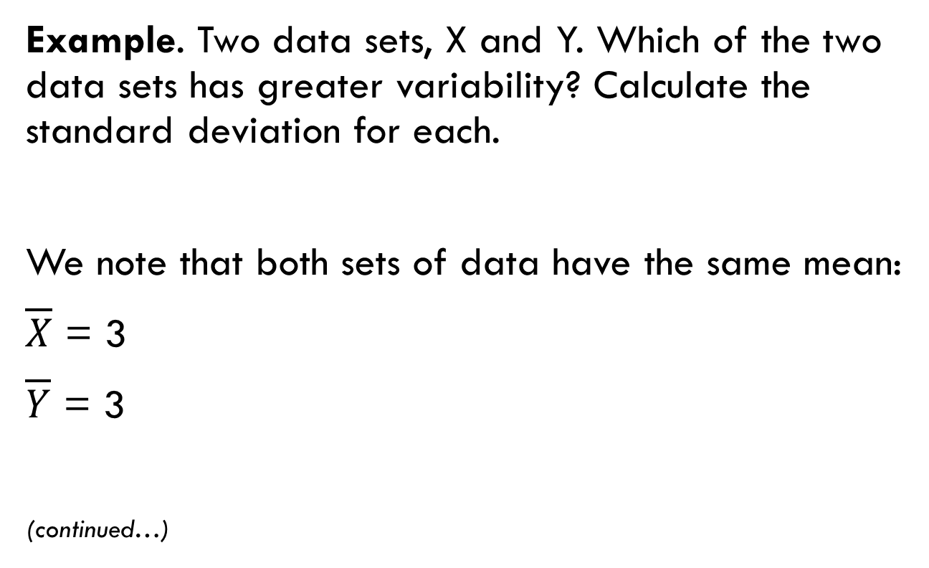
Standard Deviation
Example. Two data sets, X and Y. Which of the two data sets has greater variability? Calculate the standard deviation for each.
We note that both sets of data have the same mean:
$\overline{X}$ = 3
$\overline{Y}$ = 3
(continued…)
X_{i} | Y_{i}
1 | 0
2 | 0
3 | 0
4 | 5
5 | 10

Slide 27

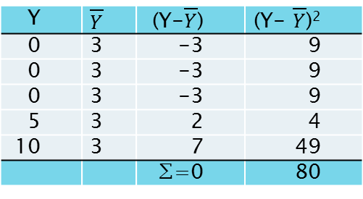
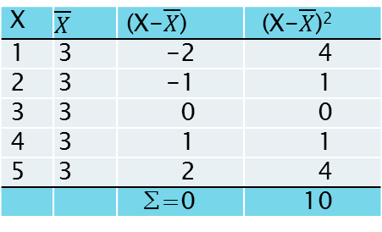
Standard Deviation
S_{X} =$\sqrt{\frac{10}{4}}$= 1.58
S_{Y} =$\sqrt{\frac{80}{4}}$= = 4.47
X | $$\overline{X}$$ | (X-$\overline{X}$) | (X-$\overline{X}$)²
1 | 3 | -2 | 4
2 | 3 | -1 | 1
3 | 3 | 0 | 0
4 | 3 | 1 | 1
5 | 3 | 2 | 4
 |  | ∑=0 | 10
Y | $\overline{Y}$ | (Y-$\overline{Y}$) | (Y- $\overline{Y}$)²
0 | 3 | -3 | 9
0 | 3 | -3 | 9
0 | 3 | -3 | 9
5 | 3 | 2 | 4
10 | 3 | 7 | 49
 |  | ∑=0 | 80

Slide 28
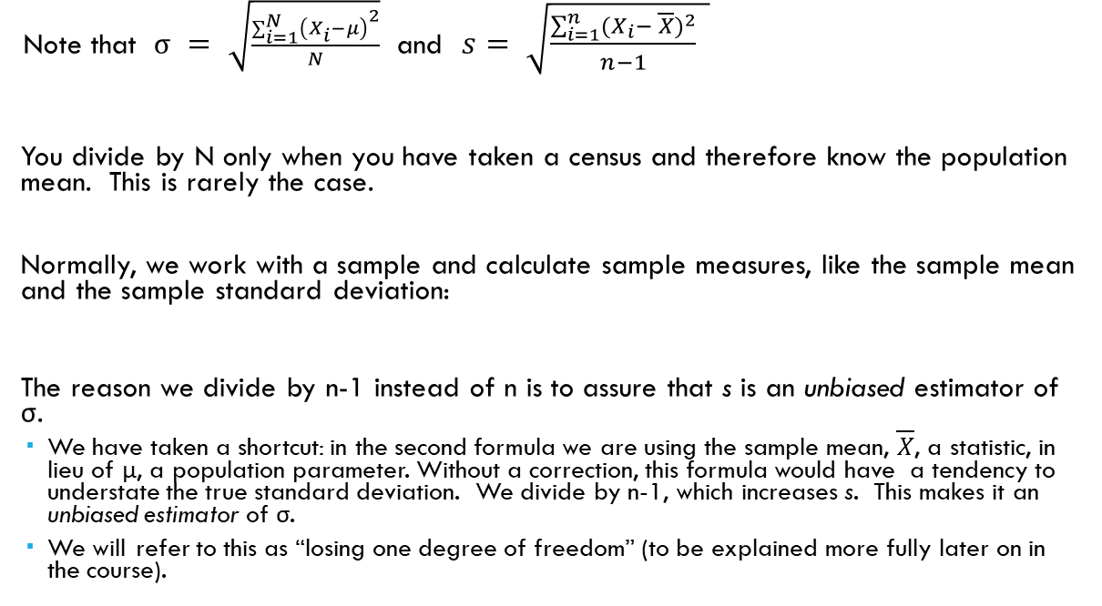
Standard Deviation: N vs. (n-1)
Note that $σ$ $= \sqrt{\frac{\sum_{i=1}^{N}{{\left(X_{i}−μ\right)}^{2}}}{N}}$ and $s= \sqrt{\frac{\sum_{i=1}^{n}{{(X_{i}− \overline{X})}^{2}}}{n−1} }$
You divide by N only when you have taken a census and therefore know the population mean. This is rarely the case.
Normally, we work with a sample and calculate sample measures, like the sample mean and the sample standard deviation:
The reason we divide by n-1 instead of n is to assure that s is an unbiased estimator of σ.
We have taken a shortcut: in the second formula we are using the sample mean, $\overline{X}$, a statistic, in lieu of μ, a population parameter. Without a correction, this formula would have a tendency to understate the true standard deviation. We divide by n-1, which increases s. This makes it an unbiased estimator of σ.
We will refer to this as “losing one degree of freedom” (to be explained more fully later on in the course).

Slide 29
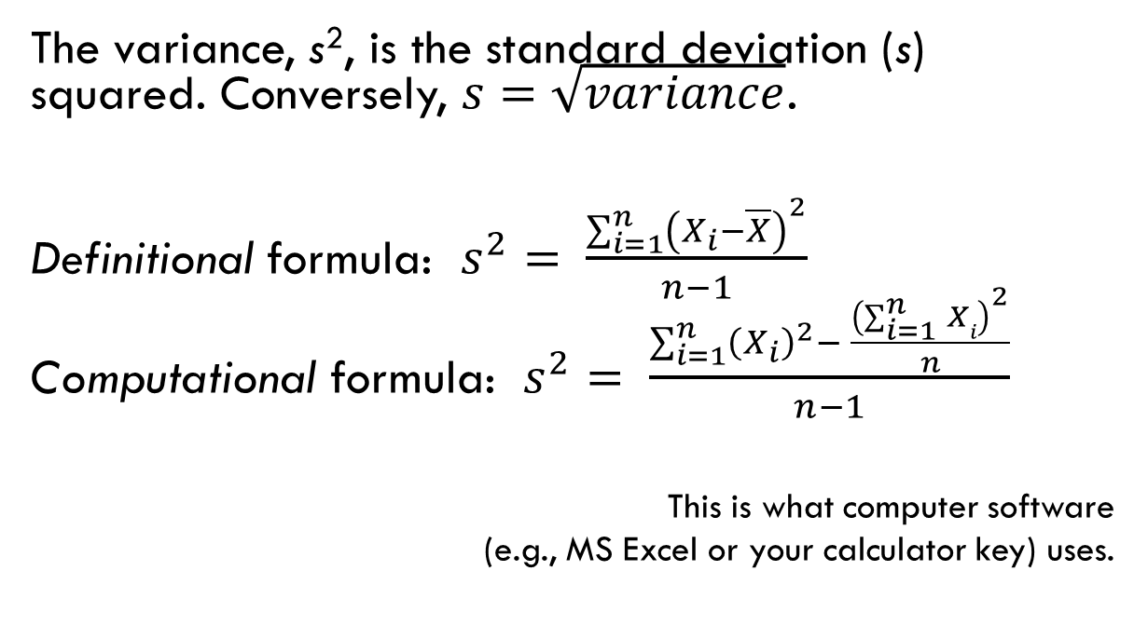
Variance
The variance, s², is the standard deviation (s) squared. Conversely, $s=\sqrt{variance}$.
Definitional formula: $s^{2}= \frac{\sum_{i=1}^{n}{{\left(X_{i}−\overline{X}\right)}^{2}}}{n−1}$
Computational formula: $s^{2}= \frac{\sum_{i=1}^{n}{{\left(X_{i}\right)}^{2}− \frac{{\left(\sum_{i=1}^{n}{Xi}\right)}^{2}}{n}}}{n−1}$
This is what computer software
(e.g., MS Excel or your calculator key) uses.

Slide 30

Coefficient of Variation (CV)
The problem with s² and s is that they are both, like the mean, in the “original” units.
This makes it difficult to compare the variability of two data sets that are in different units or where the magnitude of the numbers is very different in the two sets. For example,
Suppose you wish to compare two stocks and one is in dollars and the other is in yen; if you want to know which one is more volatile, you should use the coefficient of variation.
It is also not appropriate to compare two stocks of vastly different prices even if both are in the same units.
The standard deviation for a stock that sells for around $300 is going to be very different from one with a price of around $0.25.
The coefficient of variation will be a better measure of dispersion in these cases than the standard deviation (see example on the next slide).

Slide 31
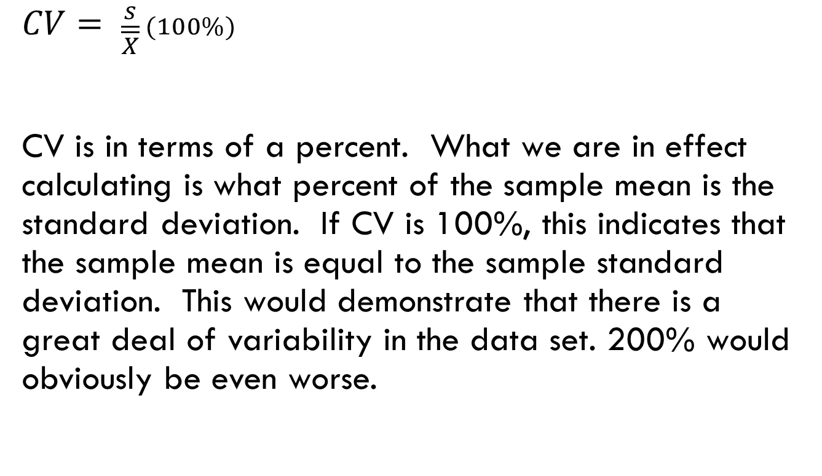
Coefficient of Variation (CV)
$$CV= \frac{s}{\overline{X}} (100\%)$$
CV is in terms of a percent. What we are in effect calculating is what percent of the sample mean is the standard deviation. If CV is 100%, this indicates that the sample mean is equal to the sample standard deviation. This would demonstrate that there is a great deal of variability in the data set. 200% would obviously be even worse.

Slide 32
Example: Stock Prices
Which stock is more volatile?
Closing prices over the last 8 months:
CV_{A} = x 100% = 95.3%
CV_{B} = x 100% = 6.0%
Answer: The standard deviation of B is higher than for A, but A is more volatile:
 | Stock A | Stock B
JAN | $1.00 | $180
FEB | 1.50 | 175
MAR | 1.90 | 182
APR | .60 | 186
MAY | 3.00 | 188
JUN | .40 | 190
JUL | 5.00 | 200
AUG | .20 | 210
Mean | $1.70 | $188.88
s² | 2.61 | 128.41
s | $1.62 | $11.33

